Slide 1
ITC 504 SOFTWARE ENGINEERING

Slide 2
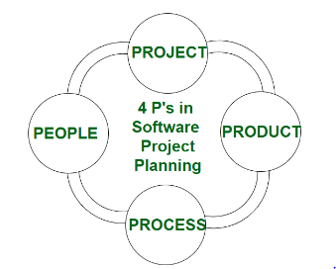
The Management Spectrum
Effective software project management focuses on the four P’s:
people,
product,
process,
project.

Slide 3
The People
People Capability Maturity Model (People-CMM)
“every organization needs to continually improve its ability to attract, develop, motivate, organize, and retain the workforce needed to accomplish its strategic business objectives”

Slide 4
The People
The people capability maturity model defines the following key practice areas for software people: staffing, communication and coordination, work environment, performance management, training, compensation, competency analysis and development, career development, workgroup development, team/culture development, and others.
Organizations that achieve high levels of People-CMM maturity have a higher likelihood of implementing effective software project management practices

Slide 5
The Product
As a software developer, you and other stakeholders must meet to define product objectives and scope.

Slide 6
The Process
Software process is a framework for the tasks that are required to build high-quality software.
A number of different task sets—tasks, milestones, work products, and quality assurance points—enable the framework activities to be adapted to the characteristics of the software project and the requirements of the project team. Finally, umbrella activities—such as software quality assurance, software configuration management, and measurement—overlay the process model.

Slide 7
The Project
Although the success rate for present-day software projects may have improved somewhat, our project failure rate remains much higher than it should be.
To avoid project failure, a software project manager and the software engineers who build the product must avoid a set of common warning signs, understand the critical success factors that lead to good project management, and develop a commonsense approach for planning, monitoring, and controlling the project

Slide 8
The People
The Stakeholders
Senior managers who define the business issues that often have a significant influence on the project.
Project (technical) managers who must plan, motivate, organize, and control the practitioners who do software work.
Practitioners who deliver the technical skills that are necessary to engineer a product or application.
Customers who specify the requirements for the software to be engineered and other stakeholders who have a peripheral interest in the outcome.
End users who interact with the software once it is released for production use

Slide 9
The People
Team Leaders:
In an excellent book of technical leadership, Jerry Weinberg suggests an MOI model of leadership:
Motivation. The ability to encourage (by “push or pull”) technical people to produce to their best ability.
Organization. The ability to mold existing processes (or invent new ones) that will enable the initial concept to be translated into a final product.
Ideas or innovation. The ability to encourage people to create and feel creative even when they must work within bounds established for a particular software product or application.

Slide 10
The People
characteristics that define an effective project manager emphasizes four key traits:
Problem solving.
Managerial identity
Achievement.
Influence and team building.

Slide 11
The People
The Software Team:
The “best” team structure depends on the management style of the organization, the number of people who will populate the team and their skill levels, and the overall problem difficulty

Slide 12
The People
Seven project factors that should be considered when planning the structure of software engineering teams:
Difficulty of the problem to be solved
“Size” of the resultant program(s) in lines of code or function points
Time that the team will stay together (team lifetime)
Degree to which the problem can be modularized
Required quality and reliability of the system to be built
Rigidity of the delivery date
Degree of sociability (communication) required for the project

Slide 13
The People
Constantine suggests four “organizational paradigms” for software engineering teams:
A closed paradigm structure
A random paradigm structure
An open paradigm structure

Slide 14
The Product
Software Scope:
The first software project management activity is the determination of software scope. Scope is defined by answering the following questions:
Context. How does the software to be built fit into a larger system, product, or business context, and what constraints are imposed as a result of the context?
Information objectives. What customer-visible data objects are produced as output from the software? What data objects are required for input?
Function and performance. What function does the software perform to transform input data into output? Are any special performance characteristics to be addressed?

Slide 15
The Process
communication, planning, modeling, construction, and deployment

Slide 16
The Project
In order to manage a successful software project, you have to understand what can go wrong so that problems can be avoided. In an excellent paper on software projects, John Reel defines 10 signs that indicate that an information systems
project is in jeopardy:
1. Software people don’t understand their customer’s needs.
2. The product scope is poorly defined.
3. Changes are managed poorly.
4. The chosen technology changes.
5. Business needs change [or are ill defined].
6. Deadlines are unrealistic.
7. Users are resistant.
8. Sponsorship is lost [or was never properly obtained].
9. The project team lacks people with appropriate skills.
10. Managers [and practitioners] avoid best practices and lessons learned

Slide 17
The Project
a five-part commonsense approach to software projects:
Start on the right foot
Maintain momentum
Track progress
Make smart decisions.
Conduct a postmortem analysis

Slide 18
Project Scheduling
Although there are many reasons why software is delivered late, most can be traced to one or more of the following root causes:
• An unrealistic deadline established by someone outside the software team
and forced on managers and practitioners.
• Changing customer requirements that are not reflected in schedule changes.
• An honest underestimate of the amount of effort and/or the number of
resources that will be required to do the job.
• Predictable and/or unpredictable risks that were not considered when the
project commenced.
• Technical difficulties that could not have been foreseen in advance.
• Human difficulties that could not have been foreseen in advance.
• Miscommunication among project staff that results in delays.
• A failure by project management to recognize that the project is falling
behind schedule and a lack of action to correct the problem.

Slide 19
Project Scheduling
Napoleon once said: “Any commander-in-chief who undertakes to carry out a
plan which he considers defective is at fault; he must put forth his reasons, insist on
the plan being changed, and finally tender his resignation rather than be the instrument of his
army’s downfall.” These are strong words that many software project
managers should ponder.

Slide 20
Project Scheduling
Software project scheduling is an action that distributes estimated effort across the
planned project duration by allocating the effort to specific software engineering
tasks. It is important to note, however, that the schedule evolves over time. During
early stages of project planning, a macroscopic schedule is developed. This type of
schedule identifies all major process framework activities and the product functions
to which they are applied. As the project gets under way, each entry on the macroscopic
schedule is refined into a detailed schedule. Here, specific software actions
and tasks (required to accomplish an activity) are identified and scheduled.

Slide 21
Project Scheduling
Like all other areas of software engineering, a number of basic principles guide
software project scheduling:
Compartmentalization. The project must be compartmentalized into a number of
manageable activities and tasks. To accomplish compartmentalization, both the
product and the process are refined.
Interdependency. The interdependency of each compartmentalized activity or
task must be determined. Some tasks must occur in sequence, while others can
occur in parallel. Some activities cannot commence until the work product produced by
another is available. Other activities can occur independently.

Slide 22
Project Scheduling
Time allocation. Each task to be scheduled must be allocated some number of
work units (e.g., person-days of effort). In addition, each task must be assigned a
start date and a completion date that are a function of the interdependencies and
whether work will be conducted on a full-time or part-time basis

Slide 23
Project Scheduling
Effort validation. Every project has a defined number of people on the software
team. As time allocation occurs, you must ensure that no more than the allocated
number of people has been scheduled at any given time.
Defined responsibilities. Every task that is scheduled should be assigned to a
specific team member.
Defined outcomes. Every task that is scheduled should have a defined outcome.
For software projects, the outcome is normally a work product (e.g., the design of
a component) or a part of a work product. Work products are often combined in
deliverables.

Slide 24
Project Scheduling
Defined milestones. Every task or group of tasks should be associated with a
project milestone. A milestone is accomplished when one or more work products
has been reviewed for quality and has been approved.
Each of these principles is applied as the project schedule evolves

Slide 25
Project Scheduling
The Relationship Between People and Effort
There is a common myth that is still believed by many managers who are
responsible for software development projects: “If we fall behind schedule, we can
always add more programmers and catch up later in the project.” Unfortunately,
adding people late in a project often has a disruptive effect on the project, causing
schedules to slip even further. The people who are added must learn the system, and
the people who teach them are the same people who were doing the work. While
teaching, no work is done, and the project falls further behind

Slide 26
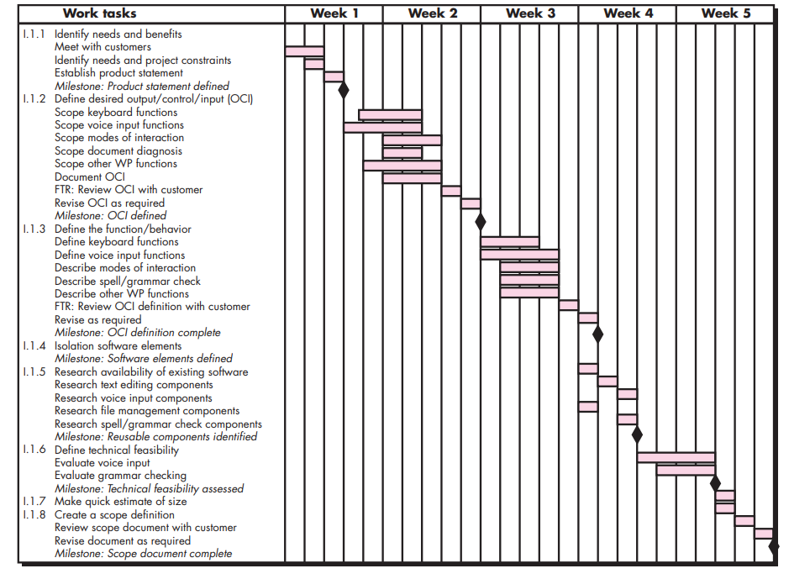
Project Scheduling

Slide 27
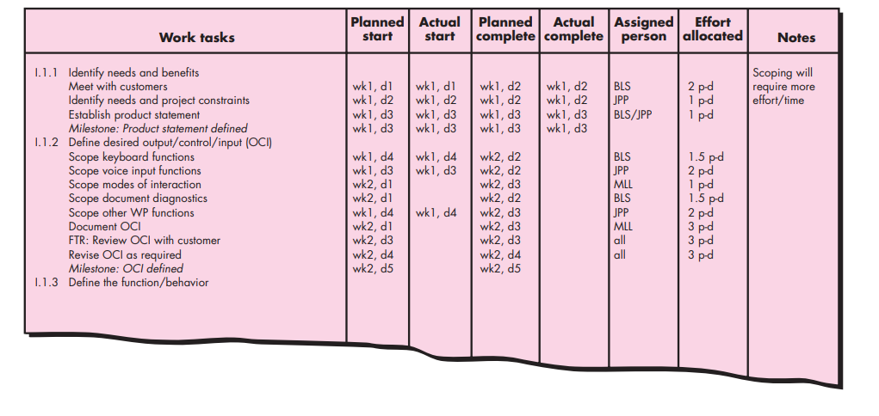
Project Scheduling

Slide 28
Project Scheduling
Tracking the Schedule
If it has been properly developed, the project schedule becomes a road map that
defines the tasks and milestones to be tracked and controlled as the project
proceeds. Tracking can be accomplished in a number of different ways:
• Conducting periodic project status meetings in which each team member reports progress and problems
• Evaluating the results of all reviews conducted throughout the software engineering process
• Determining whether formal project milestones (the diamonds shown in have been accomplished by the scheduled date

Slide 29
Project Scheduling
• Comparing the actual start date to the planned start date for each project task listed in the resource table
• Meeting informally with practitioners to obtain their subjective assessment of progress to date and problems on the horizon
• Using earned value analysis to assess progress quantitatively

Slide 30
Software engineering metrics
Software engineering metrics are quantitative measures used to assess various aspects of the software development process, software quality, and project management.
These metrics provide valuable insights into the progress, efficiency, and overall health of a software project.
By analyzing these metrics, software engineering teams can make informed decisions, identify areas for improvement, and ensure the successful completion of projects.

Slide 31
Software engineering metrics
1. Process Metrics:
Process metrics are measurements used to assess various aspects of the software development process.
They provide insights into the efficiency, effectiveness, and health of the processes being employed during software development.
Process metrics help teams identify bottlenecks, areas for improvement, and potential risks.
These metrics are crucial for maintaining consistency, predictability, and quality in the software development lifecycle.
Some examples of process metrics include:

Slide 32
Software engineering metrics
Lead Time: The time taken from initiating a task to its completion.
Cycle Time: The time taken for a task to move through the development pipeline.
Throughput: The number of tasks completed within a specified time frame.
Efficiency: The ratio of productive time to non-productive time.
Work in Progress (WIP): The number of tasks currently in progress.
Defect Density: The number of defects identified per unit of code.
Code Churn: The rate at which code is added, modified, or removed.
Code Review Turnaround Time: The time taken to review and provide feedback on code changes.

Slide 33
Software engineering metrics
2. Product Metrics:
Product metrics focus on the characteristics and attributes of the software product itself.
They provide insights into the quality, reliability, and performance of the software.
Product metrics are used to assess whether the software meets the desired standards and requirements.
These metrics help in understanding the software's functionality, stability, and overall user experience.
Some examples of product metrics include:

Slide 34
Software engineering metrics
Functionality: The features and capabilities offered by the software.
Reliability: The software's ability to perform as expected without errors or failures.
Performance: How well the software performs in terms of speed and responsiveness.
Usability: The ease of use and user satisfaction with the software's interface.
Security: The level of protection against unauthorized access and data breaches.
Scalability: The software's ability to handle increased workloads and users.
Maintainability: How easily the software can be modified and maintained over time.
Portability: The software's ability to run on different platforms and environments.

Slide 35
Software engineering metrics
Size-Oriented Metrics:
Size-oriented metrics focus on measuring the size of the software product.
These metrics provide insights into the volume of code, the effort required, and the complexity of the software.
They are particularly useful in estimating project effort, cost, and schedule.
Size = Kilo Lines of Code (KLOC)
Effort = Person / month
Productivity = KLOC / person-month
Quality = Number of faults / KLOC
Cost = $ / KLOC
Documentation = Pages of documentation / KLOC

Slide 36
Software engineering metrics
LOC (Lines of Code) is a commonly used metric in software engineering to measure the size of a computer program or software component by counting the number of lines of code in the source code files.
It provides a rough estimate of the scale and complexity of a software project. However, it's important to note that while LOC is easy to measure, it has limitations and should be used with caution.
How LOC is Counted: Counting lines of code involves tallying the number of lines that contain actual code instructions, as well as lines with comments and blank lines. There are variations in how LOC is counted:

Slide 37
Software engineering metrics
Physical Lines of Code: This includes all lines, including blank lines and lines with comments.
Logical Lines of Code: This counts lines with actual executable code, excluding blank lines and lines with comments.
Executable Lines of Code: This counts lines with executable statements, excluding lines with only declarations and comments.
Pros of Using LOC:
Quick Estimation: LOC can provide a quick, rough estimation of the size of a software project, which can be useful for high-level planning.
Comparative Analysis: It allows for comparing the size of different components or projects, giving a relative measure of complexity.
Historical Data: Over time, trends in LOC can provide insights into codebase growth and development effort.

Slide 38
Software engineering metrics
Cons of Using LOC:
Code Complexity: LOC doesn't consider the complexity of the code, which means a shorter code with intricate logic can be more complex than a longer, straightforward code.
Programming Language Differences: Different programming languages and coding styles can lead to varying LOC counts for the same functionality.
Maintenance Impact: Focusing solely on LOC can encourage writing longer code to meet metrics, which can negatively impact code maintainability and readability.
Quality and Efficiency: LOC doesn't measure the quality, efficiency, or effectiveness of the code, leading to a narrow focus on quantity rather than quality.
Refactoring and Optimization: Refactoring or optimizing code might lead to a decrease in LOC, but an improvement in overall quality and performance.

Slide 39
Software engineering metrics
Function Points (FP) is a software metric used to measure the functionality provided by a software application from the user's perspective.
It quantifies the software's value to end-users, regardless of the underlying technology or programming language.
Function Points provide a more comprehensive and meaningful measure of software size compared to metrics like lines of code (LOC), as they focus on what the software does rather than how it's implemented.
Function Points are calculated based on different types of user interactions with the software, which are classified into five categories:
External Inputs (EI): These are inputs provided by users to the software. An input can be a data entry or a request for processing. Each unique external input is counted separately. For example, in a banking application, entering customer information and processing a transaction would be considered external inputs.

Slide 40
Software engineering metrics
External Outputs (EO): These are outputs generated by the software for users. An output can be a report, display, or file created by the system. Each unique external output is counted separately. For instance, generating a monthly account statement would be considered an external output.
External Inquiries (EQ): These are queries or requests for information from users that the software must process. Each unique external inquiry is counted separately. An example would be users checking their account balance in an online banking system.
Internal Logical Files (ILF): These represent user-identifiable data maintained by the system. An ILF is counted for each distinct logical file maintained by the system. For example, in a library management system, the database of books and the database of borrowers would be considered separate internal logical files.
External Interface Files (EIF): These are logical files used by the software to communicate with other applications or systems. An EIF is counted for each distinct external interface file. For instance, an interface with a payment gateway in an e-commerce system would be considered an external interface file.

Slide 41
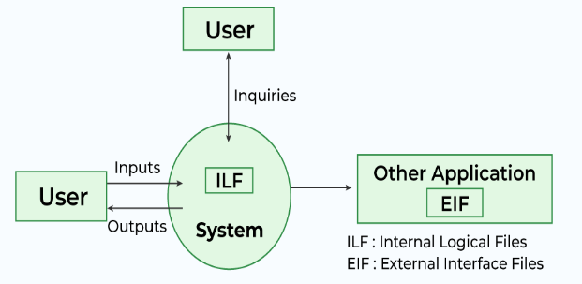
Software engineering metrics

Slide 42
Software engineering metrics
Function Points = (Sum of Weighting Factors) × (Adjustment Factor)
The calculation involves assigning complexity levels (Low, Average, High) to each of the user interaction types (EI, EO, EQ, ILF, EIF). Each complexity level is associated with a predetermined weighting value.
The adjustment factor accounts for the overall complexity of the software due to factors like data communications, distributed processing, performance, and more.

Slide 43
Software engineering metrics
Counting Function Point (FP):
Step-1:
F = 14 * scale
Scale varies from 0 to 5 according to character of Complexity Adjustment Factor (CAF). Below table shows scale:
0 - No Influence
1 - Incidental
2 - Moderate
3 - Average
4 - Significant
5 - Essential

Slide 44
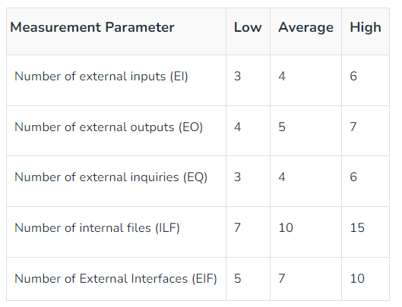
Software engineering metrics
Step-2: Calculate Complexity Adjustment Factor (CAF).
CAF = 0.65 + ( 0.01 * F )
Step-3: Calculate Unadjusted Function Point (UFP).
TABLE (Required)
Multiply each individual
function point to
corresponding values in
TABLE.

Slide 45
Software engineering metrics
Step-4: Calculate Function Point.
FP = UFP * CAF

Slide 46
Software engineering metrics
Example:
Given the following values, compute function point when all complexity adjustment factor (CAF) and weighting factors are average.
User Input = 50
User Output = 40
User Inquiries = 35
User Files = 6
External Interface = 4

Slide 47
Software engineering metrics
Step-1: As complexity adjustment factor is average (given in question), hence,
scale = 3.
F = 14 * 3 = 42
Step-2:
CAF = 0.65 + ( 0.01 * 42 ) = 1.07
Step-3: As weighting factors are also average (given in question) hence we will multiply each individual function point to corresponding values in TABLE.
UFP = (50*4) + (40*5) + (35*4) + (6*10) + (4*7) = 628
Step-4:
Function Point = 628 * 1.07 = 671.96

Slide 48
Software engineering metrics
Scenario: Calculate the function point, productivity, documentation, and cost per function for software application with multiple Processing Factors 5, 1, 0, 4, 3, 5, 4, 3, 4, 5, 2, 3, 4, 2 by using following given Date:
The number of EI(Avg): 22,
The number of EO(Low): 45,
The number of EI(High): 06,
The number of ILF(Avg): 05,
The number of ELF(Low): 02,
Effort:37 P/M,
Software technical documents: 250 pages,
User related documents: 120 pages and
Cost: $7520 per month.

Slide 49
Software engineering metrics
Solution: Total Cost Factor (TC) = (22*4) + (45*5) + (06*6) + (05*10) + (02*5)
= 409
Function Point (FP) = TC *[0.65 + 0.01*∑ (Xi)]
= 409 *[0.65 + 0.01*(5+1+0+4+3+ 5+4+3+4+5+ 2+3+ 4+2)]
= 409 * [0.65 + 0.01*45]
= 409 * [0.65 + 0.45]
= 409* 1.10
= 450

Slide 50
Software engineering metrics
Productivity (P) = FP /Effort
=450/37
= 12.16
Total Page of Documentation (PD) = Software Technical Documents + User related documents
= 250 + 120
= 370 pages
Documentation = Pages of documentation/FP
= 370/450
=0.82

Slide 51
Software engineering metrics
Cost of each Functionalities = COST/Productivity
=7520/12.16
=$618.421
= $618.5

Slide 52
Software engineering metrics
Function Points are used primarily for project estimation, cost estimation, and comparing the productivity of different software development projects. They provide a way to quantify the functional size of software in a manner that transcends the intricacies of different programming languages and technologies.

Slide 53
Software engineering metrics
3. Project Metrics:
Project metrics provide insights into the management and progress of the software development project itself.
They help project managers and stakeholders monitor the project's health, track milestones, and make informed decisions.
Project metrics are essential for estimating project timelines, managing resources, and ensuring that the project stays on track.
Some examples of project metrics include:

Slide 54
Software engineering metrics
Schedule Variance: The difference between planned and actual project timelines.
Cost Variance: The difference between planned and actual project costs.
Earned Value: A measure of the value of work completed compared to the planned work.
Risk Metrics: Measurement of identified project risks and their potential impact.
Resource Utilization: How effectively project resources are being utilized.
Defect Turnaround Time: The time taken to fix defects or issues after identification.
Change Request Rate: The frequency of requested changes to project scope or requirements.
Stakeholder Satisfaction: The satisfaction level of stakeholders with the project's progress and outcomes.

Slide 55
It is reasonable to ask whether
there is a quantitative technique for assessing progress as the software team progresses
through the work tasks allocated to the project schedule. In fact, a technique for performing
quantitative analysis of progress does exist. It is called earned value
analysis (EVA)
The earned value system provides a common value scale for every [software project]
task, regardless of the type of work being performed. The total hours to do the whole
project are estimated, and every task is given an earned value based on its estimated
percentage of the total.

Slide 56
Earned value analysis (EVA)
It is reasonable to ask whether there is a quantitative technique for assessing progress as
the software team progresses through the work tasks allocated to the project schedule. In
fact, a technique for performing quantitative analysis of progress does exist. It is called
earned value analysis (EVA)
The earned value system provides a common value scale for every [software project]
task, regardless of the type of work being performed. The total hours to do the whole
project are estimated, and every task is given an earned value based on its estimated
percentage of the total.
Stated even more simply, earned value is a measure of progress. It enables you to
assess the “percent of completeness” of a project using quantitative analysis rather
than rely on a gut feeling

Slide 57
Earned value analysis (EVA)
To determine the earned value, the following steps
are performed:
1. The budgeted cost of work scheduled (BCWS) is determined for each work task
represented in the schedule. During estimation, the work (in person-hours or
person-days) of each software engineering task is planned. Hence, BCWSi is
the effort planned for work task i. To determine progress at a given point
along the project schedule, the value of BCWS is the sum of the BCWSi values
for all work tasks that should have been completed by that point in time on
the project schedule.

Slide 58
Earned value analysis (EVA)
The BCWS values for all work tasks are summed to derive the budget at
completion (BAC). Hence,
BAC (BCWSk) for all tasks k
3. Next, the value for budgeted cost of work performed (BCWP) is computed. The
value for BCWP is the sum of the BCWS values for all work tasks that have
actually been completed by a point in time on the project schedule.

Slide 59
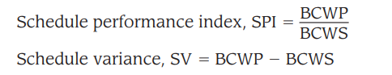
Earned value analysis (EVA)
t “the distinction between the BCWS and the BCWP is
that the former represents the budget of the activities that were planned to be completed and the latter represents the budget of the activities that actually were
completed.” Given values for BCWS, BAC, and BCWP, important progress indicators
can be computed:

Slide 60
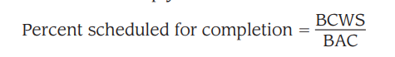
Earned value analysis (EVA)
SPI is an indication of the efficiency with which the project is utilizing scheduled
resources. An SPI value close to 1.0 indicates efficient execution of the project
schedule. SV is simply an absolute indication of variance from the planned schedule.

Slide 61
Earned value analysis (EVA)
SPI is an indication of the efficiency with which the project is utilizing scheduled
resources. An SPI value close to 1.0 indicates efficient execution of the project
schedule. SV is simply an absolute indication of variance from the planned schedule.
provides an indication of the percentage of work that should have been completed
by time t

Slide 62
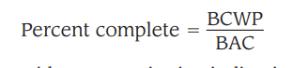
Earned value analysis (EVA)
provides a quantitative indication of the percent of completeness of the project at a
given point in time t.

Slide 63
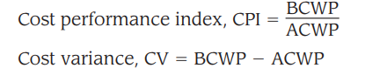
Earned value analysis (EVA)
It is also possible to compute the actual cost of work performed (ACWP). The
value for ACWP is the sum of the effort actually expended on work tasks that have
been completed by a point in time on the project schedule. It is then possible to
Compute
A CPI value close to 1.0 provides a strong indication that the project is within its
defined budget. CV is an absolute indication of cost savings (against planned costs)
or shortfall at a particular stage of a project.
Like over-the-horizon radar, earned value analysis illuminates scheduling difficulties before they might otherwise be apparent. This enables you to take corrective
action before a project crisis develops

Slide 64
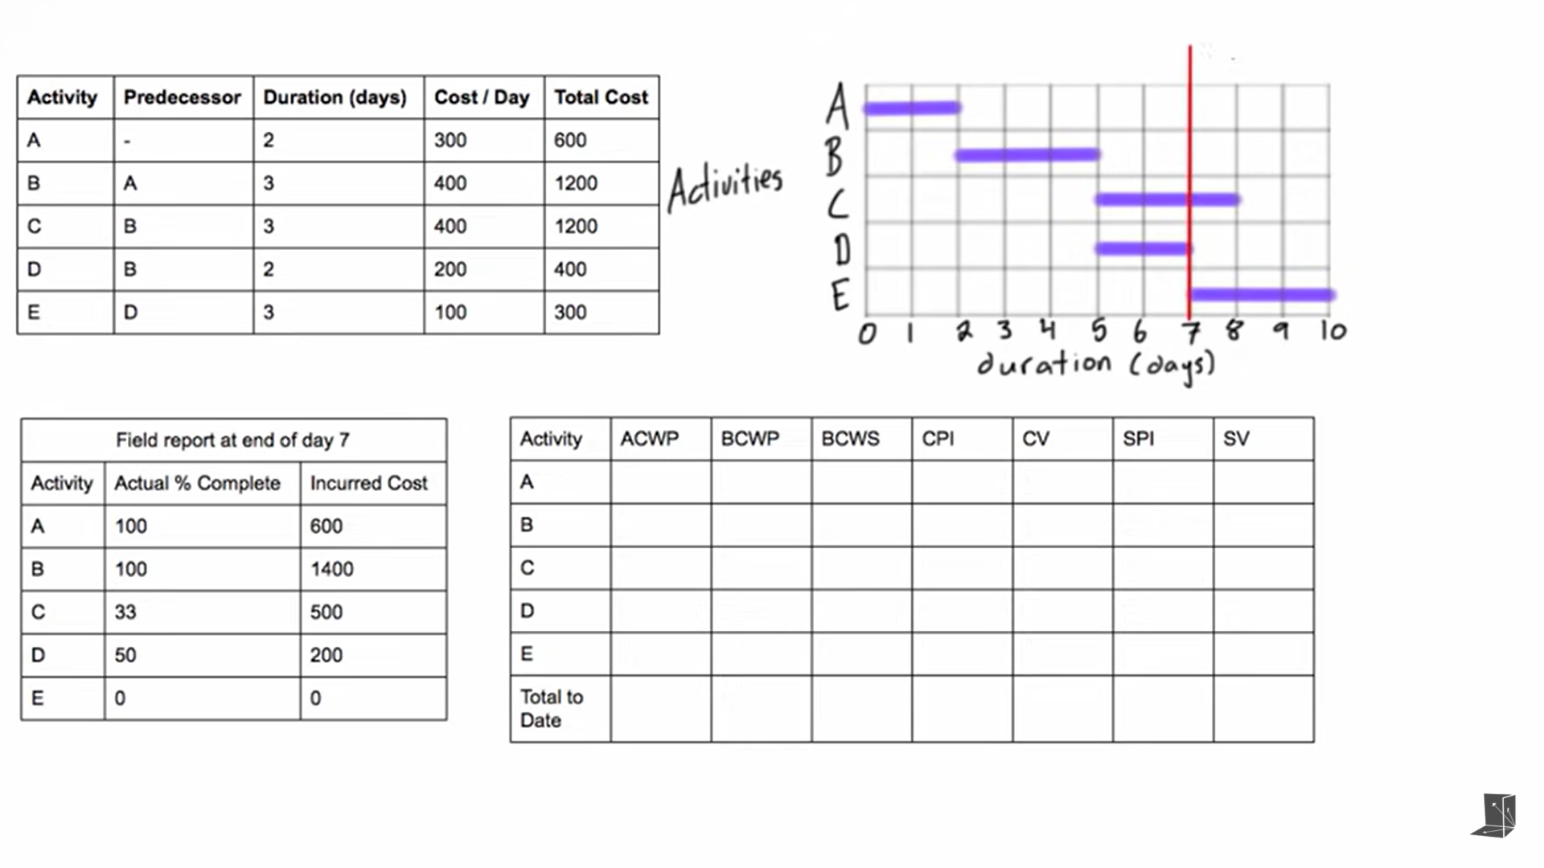
Earned Value Analysis

Slide 65
Earned Value Analysis
ACWP- Actual Cost of Work Performed: How much we paid for the work done so far

Slide 66
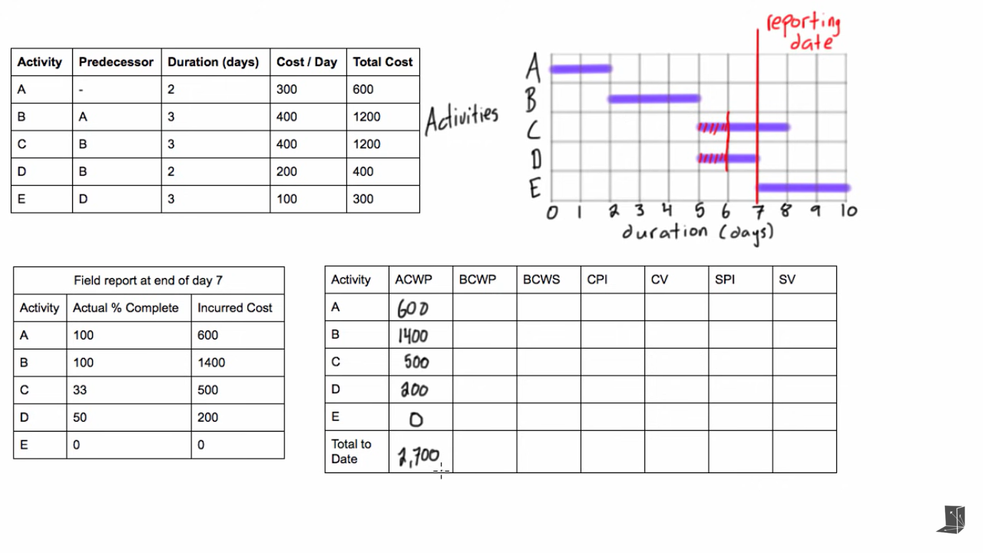
Earned Value Analysis

Slide 67
Earned Value Analysis
BCWP- Budgeted Cost of Work Performed: How much money we are expecting to pay for the amount of work that was actually completed

Slide 68
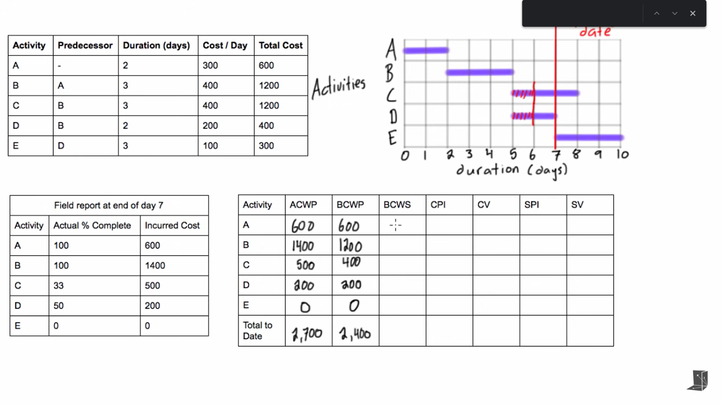
Earned Value Analysis

Slide 69
Earned Value Analysis
BCWS- Budgeted Cost of Work Scheduled: How much we expected to pay for each activity that we had expected to finish by the reporting date.

Slide 70
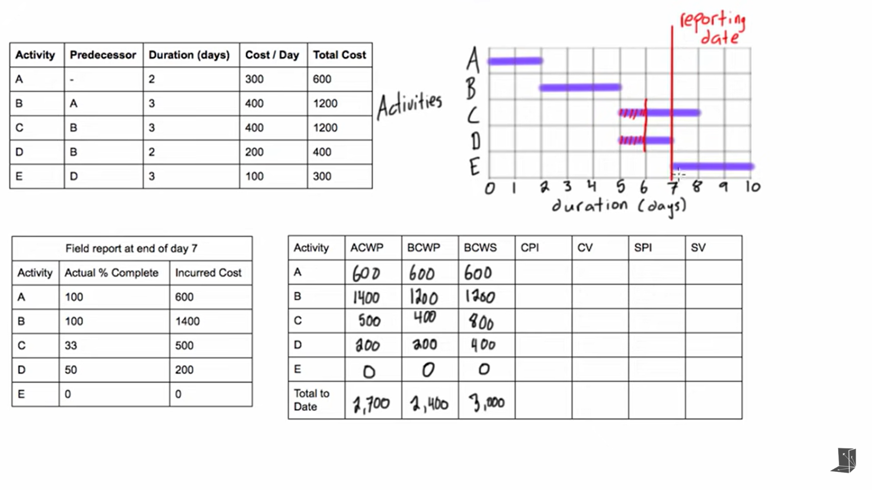
Earned Value Analysis

Slide 71
Earned Value Analysis
CPI(Cost Performance Index)= BCPW/ACPW
CV(Cost Variance) = BCPW-ACPW
SPI(Schedule Performance Index)= BCWP/BCWS
SV(Schedule Variance)= BCWP-BCWS

Slide 72
Earned Value Analysis
CPI<1
Project is over budget
CV<0
Project is over budget
SPI<1
Project is behind Schedule
SPI<0
Project is behind schedule

Slide 73
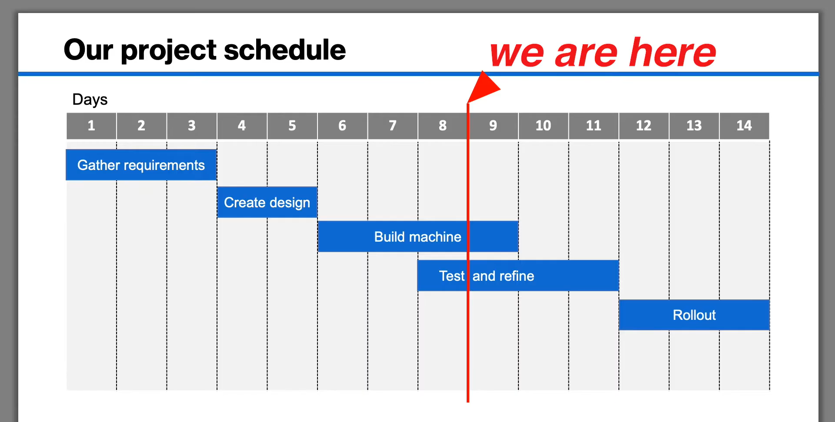
Earned Value Analysis

Slide 74
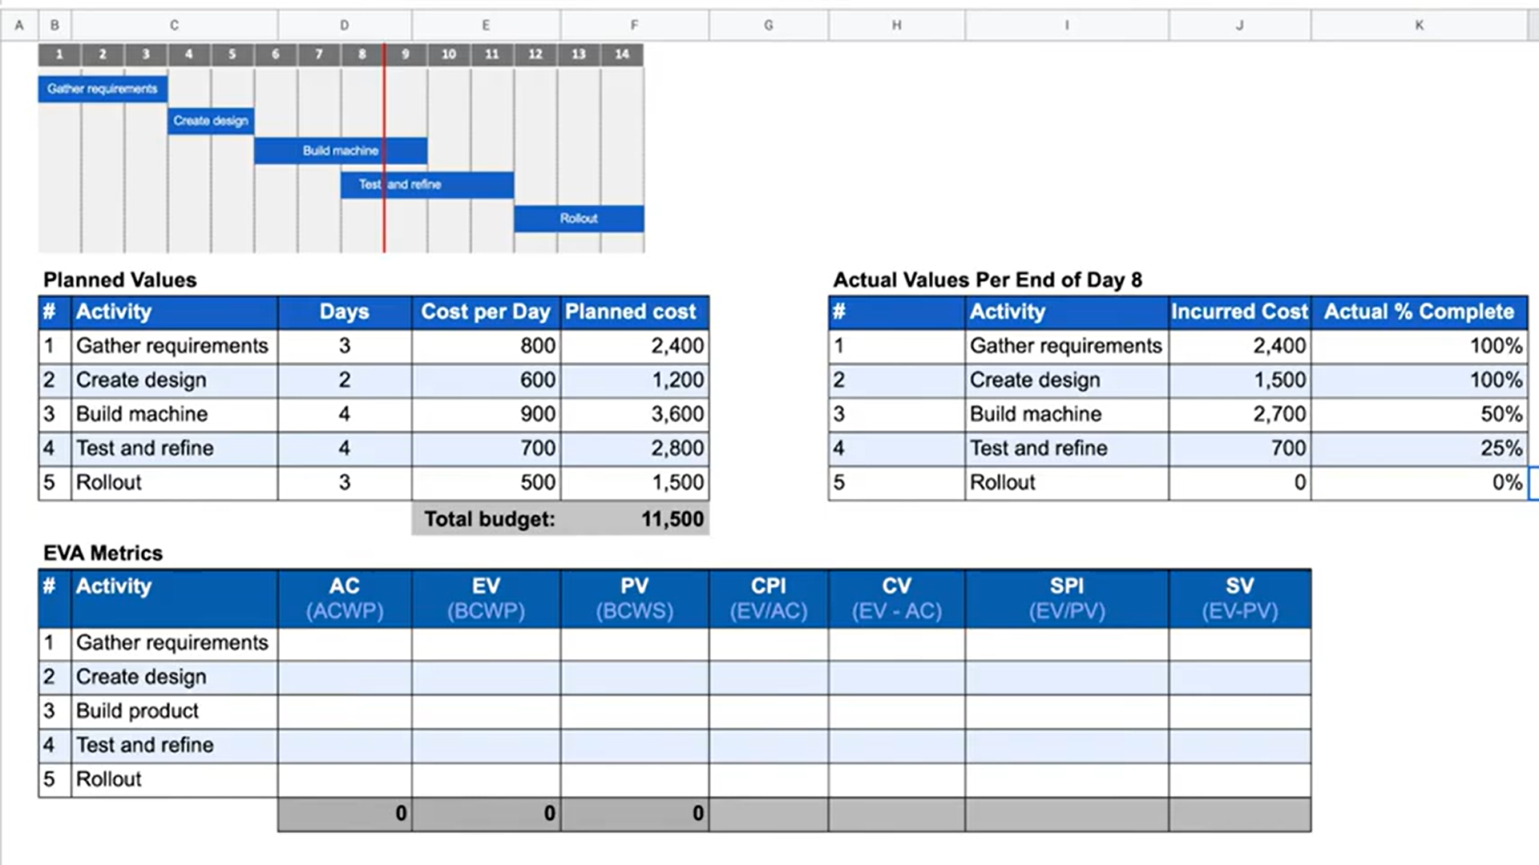
Earned Value Analysis

Slide 75
COCOMO-1
COCOMO is Constructive Cost Model, On the basic level it is the cost estimation model.
• Using this model you can find or you can make estimates of the cost of your project.
• Key Parameters of Model:
• Effort : Means how much amount of labor is required to complete a task. (Unit: Person-Month).
• Schedule: Means amount of time required for the completion of job.

Slide 76
COCOMO
1. Organic Project
It belongs to small & simple software projects which are handled by a small team with good domain knowledge and few rigid requirements.
Example: Small data processing or Inventory management system.
2. Semidetached Project
It is an intermediate (in terms of size and complexity) project, where the team having mixed experience (both experience & inexperience resources) to deals with rigid/nonrigid requirements.
Example: Database design or OS development.
3. Embedded Project
This project having a high level of complexity with a large team size by considering all sets of parameters (software, hardware and operational).
Example: Banking software or Traffic light control software.

Slide 77
COCOMO
Types of COCOMO Model
Depending upon the complexity of the project the COCOMO has three types. Such as:
1. The Basic COCOMO
It is the one type of static model to estimates software development effort quickly and roughly. It mainly deals with the number of lines of code and the level of estimation accuracy is less as we don’t consider the all parameters belongs to the project. The estimated effort and scheduled time for the project are given by the relation:
Effort (E) = a*(KLOC)b MM
Scheduled Time (D) = c*(E)d Months(M)
Where,
E = Total effort required for the project in Man-Months (MM).
D = Total time required for project development in Months (M).
KLOC = the size of the code for the project in Kilo lines of code.
a, b, c, d = The constant parameters for a software project.

Slide 78
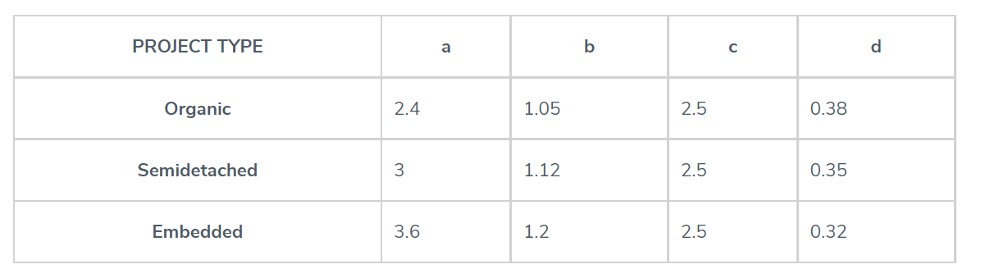
COCOMO

Slide 79
COCOMO
Example: For a given project was estimated with a size of 300 KLOC. Calculate the Effort, Scheduled time for development. Also, calculate the Average resource size and Productivity of the software for Organic project type.
Ans: Given estimated size of project is: 300 KLOC
For Organic
Effort (E) = a*(KLOC)b = 2.4*(300)1.05 = 957.61 MM
Scheduled Time (D) = c*(E)d = 2.5*(957.61)0.38 = 33.95 Months(M)
Avg. Resource Size = E/D = 957.61/33.95 = 28.21 Mans

Slide 80
COCOMO
For Semidetached
Effort (E) = a*(KLOC)b = 3.0*(300)1.12 = 1784.42 MM
Scheduled Time (D) = c*(E)d = 2.5*(1784.42)0.35 = 34.35 Months(M)
For Embedded
Effort (E) = a*(KLOC)b = 3.6*(300)1.2 = 3379.46 MM
Scheduled Time (D) = c*(E)d = 2.5*(3379.46)0.32 = 33.66 Months(M)

Slide 81
COCOMO
The intermediate model estimates software development effort in terms of size of the program and other related cost drivers parameters (product parameter, hardware parameter, resource parameter, and project parameter) of the project. The estimated effort and scheduled time are given by the relationship:
Effort (E) = a*(KLOC)b *EAF MM
Scheduled Time (D) = c*(E)d Months(M)

Slide 82
COCOMO
Where,
E = Total effort required for the project in Man-Months (MM).
D = Total time required for project development in Months (M).
KLOC = The size of the code for the project in Kilo lines of code.
a, b, c, d = The constant parameters for the software project.
EAF = It is an Effort Adjustment Factor, which is calculated by multiplying the parameter values of different cost driver parameters. For ideal, the value is 1.

Slide 83
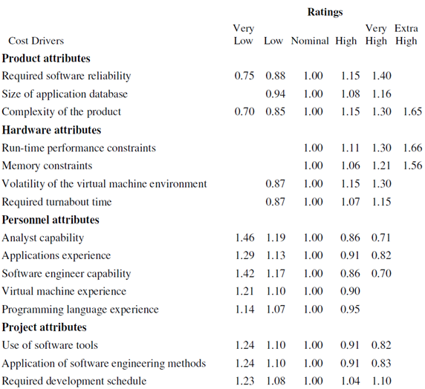
COCOMO

Slide 84
COCOMO
Example: For a given project was estimated with a size of 300 KLOC. Calculate the Effort, Scheduled time for development by considering developer having high application experience and very low experience in programming.

Slide 85
COCOMO
Ans:
Given the estimated size of the project is: 300 KLOC
Developer having highly application experience: 0.82 (as per above table)
Developer having very low experience in programming: 1.14(as per above table)
EAF = 0.82*1.14 = 0.9348
Effort (E) = a*(KLOC)b *EAF = 3.0*(300)1.12 *0.9348 = 1668.07 MM
Scheduled Time (D) = c*(E)d = 2.5*(1668.07)0.35 = 33.55 Months(M)

Slide 86
COCOMO
Advantages and Disadvantages of COCOMO Model
Following are some advantages and disadvantages of the COCOMO model.
Advantages
Easy to estimate the total cost of the project.
Easy to implement with various factors.
Provide ideas about historical projects.
Disadvantages
It ignores requirements, customer skills, and hardware issues.
It limits the accuracy of the software costs.
It mostly depends on time factors.

